Slide 1
Content Distribution Network

Slide 2
GROUP MEMBERS
Muhammad Talha-F2021408057
Saadullad-F2021408036
Umair-F2021105251
Ali Zain-F2021105042
Fahad Nauman-F2021408015
Mian Muhammad Bilal-F2021408054

Slide 3
TABLE OF CONTENTS
01
04
02
05
03
06
Introduction to CDN
Benefits and Advantages of CDN
CDN and Mobile Content Delivery
CDN Performance Optimization Techniques
CDN Architecture and Components
Caching and Content Replication in CDN
Case Studies: Popular CDN Providers
Emerging Trends in CDN Technology
CDN Routing and Load Balancing
CDN Security and DDoS Protection
Challenges and Limitations of CDN
Future of CDN and Conclusion

Slide 4
Introduction
Content Distribution Network (CDN) is a network of distributed servers that deliver web content to users based on their geographic location, improving performance and user experience. CDN reduces latency, improves content availability, and enhances website performance. CDN nodes are strategically located worldwide to bring content closer to end users.

Slide 5
Advantages
Faster Content Delivery: CDN reduces the distance between content and users, resulting in faster delivery and improved page load times.
Scalability and Reliability: CDN can handle high traffic loads and distribute content efficiently across multiple servers.
DDoS Mitigation: CDN acts as a shield against DDoS attacks by filtering malicious traffic and protecting the origin server.

Slide 6
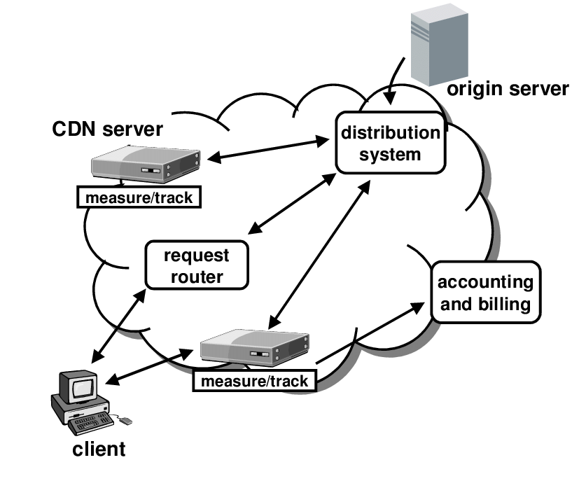
CDN Architecture
Origin Server: Main server hosting the original content.
Edge Servers: Geographically distributed caching servers.
Distribution Nodes: Connect origin server to edge servers.
Control Plane: Manages CDN infrastructure.

Slide 7
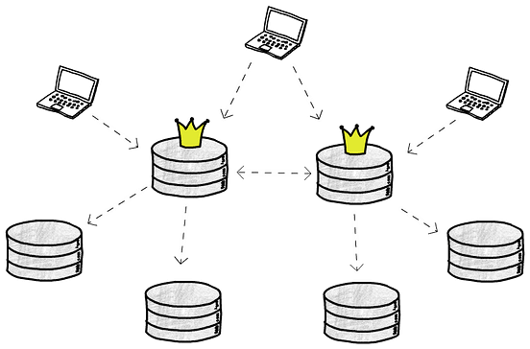
Caching and Content Replication
Caching: Storing static and dynamic content at edge servers.
Content Replication: Replicating content for redundancy and real-time updates.

Slide 8
CDN Routing and Load Balancing
CDN routing :
CDN routing is a process that helps to deliver content to users quickly and efficiently. It works by routing requests to the closest server to the user, which reduces latency and improves performance. CDN routing also helps to reduce bandwidth costs by caching content on the edge of the network, allowing for faster delivery of content.
Load Balancing : CDN load balancing is a process of distributing web traffic across multiple servers in order to improve website performance and reduce server load. It is used to ensure that web content is delivered quickly and reliably to users, without geographic location.

Slide 9
CDN Security and DDoS Protection
CDN Security:
CDN security is the process of protecting content delivery networks (CDNs) from malicious attacks and unauthorized access. CDN security measures include encryption, authentication, access control, and monitoring. CDN providers also use firewalls, and other security measures to protect their networks.
DDoS Protection :
DDoS protection is a set of tools and services designed to protect a network or system from distributed denial-of-service (DDoS) attacks. These tools and services can include firewalls, intrusion detection and prevention systems, traffic scrubbing services, and other technologies.

Slide 10
CDN and Mobile Content Delivery
It is a distributed network of servers located in various data centers around the world. The primary purpose of a CDN is to deliver web content, such as images, videos, CSS files, and JavaScript files, to end-users with high performance and availability.
On the other hand, Mobile content delivery refers specifically to the delivery of content to mobile devices, such as smartphones and tablets. With the increasing usage of mobile devices for internet access, optimizing content delivery for mobile users has become crucial.

Slide 11
CDN Performance Optimization Techniques
Caching: A fundamental technique, it involves storing copies of content on servers located at edge locations
Content Preloading: Proactively preload popular or frequently accessed content onto edge servers.
Content Compression: CDNs often compress content before transmitting it to end-users.
Image Optimization: CDN reduces the size of images without compromising visual quality.
HTTP/2 and HTTP/3 Support: It is having features like multiplexing, server push, and reduced latency.

Slide 12
Popular CDN providers
Amazon CloudFront
Microsoft Azure CDN
Google Cloud CDN
Cloudflare

Slide 13
Emerging Technologies
Edge Computing
Multi-Cloud CDN
AI-Driven Optimization
IoT and 5G support

Slide 14
Challenges of CDN
Bandwidth and Network Congestion:
Increasing demand for high-quality content strains network bandwidth.
CDN alleviates bandwidth issues by distributing content closer to users.
Latency and Performance Issues:
Latency affects website loading time and responsiveness.
CDN reduces latency by caching content at edge servers.

Slide 15
Future Trends in CDN
Edge Computing and Edge CDN:
Video Streaming and Over-The-Top (OTT)Content:
Edge computing complements CDN infrastructure for faster processing and reduced latency.
Examples: Gaming,Live Streaming,IoT
CDN optimizes video delivery with adaptive bit-rate streaming and global distribution.
Examples:Netflix,YouTube,Amazon Prime

Slide 16
THANKS!
Does anyone have any question?
addyouremail@freepik.com

